Slide 1
Performance Comparison of Matrix Multiplication Algorithms
Pradyumna S

Slide 2
Applications of Matrix Multiplication
Google’s Pagerank
Image Processing
Context Free Grammar parsing
Computer Graphics

Slide 3
History of Matrix Multiplication Algorithms
Naïve Multiplication - O(n³).
Strassens - O(n^{2.808})
Bini et al – O(n^{2.78})
Schonhage - O(n^{2.548})
Coppersmith and Winograd - O(n^{2.496})
Strassen’s + Coppersmith and Winograd O(n^{2.376})
Virginia Vassilevska Williams - O(n^{2.373})
Francois Le Gall

Slide 4
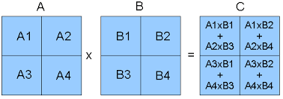
Optimization Techniques
Parallelization

Slide 5
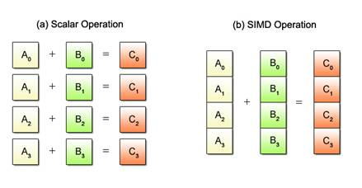
Optimization Techniques
SIMD architecture

Slide 6
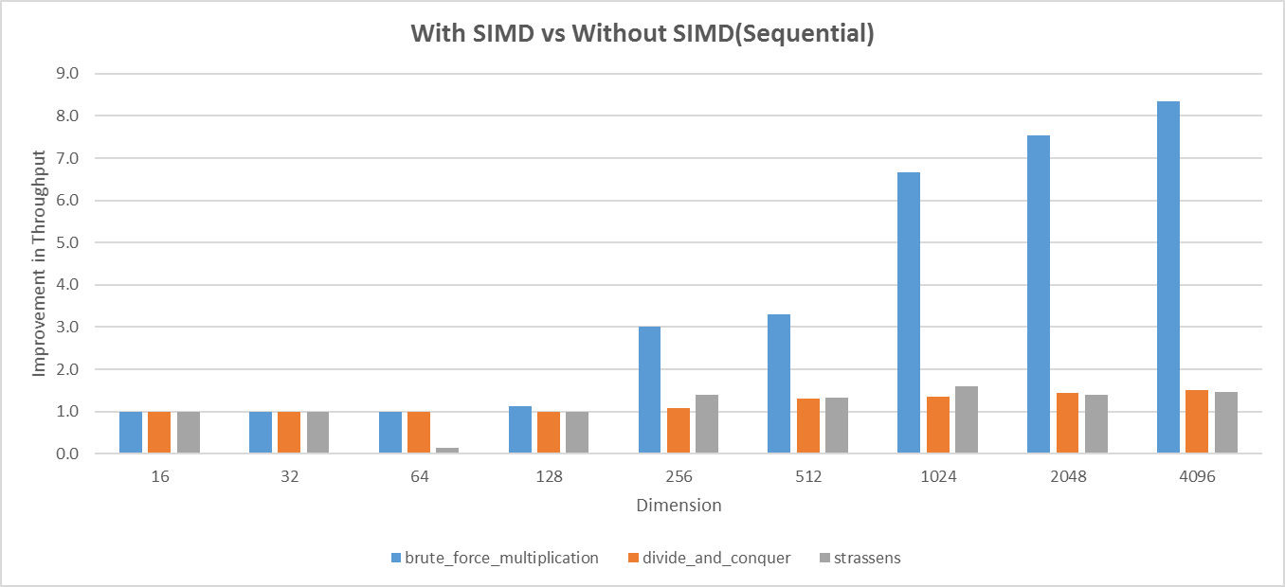
Results

Slide 7
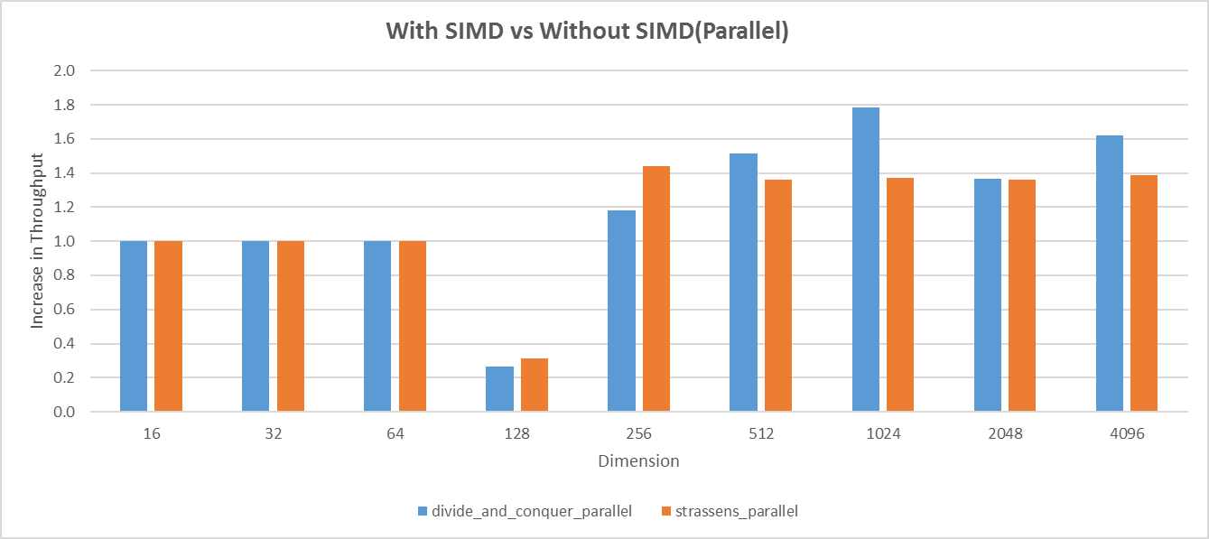
Results

Slide 8
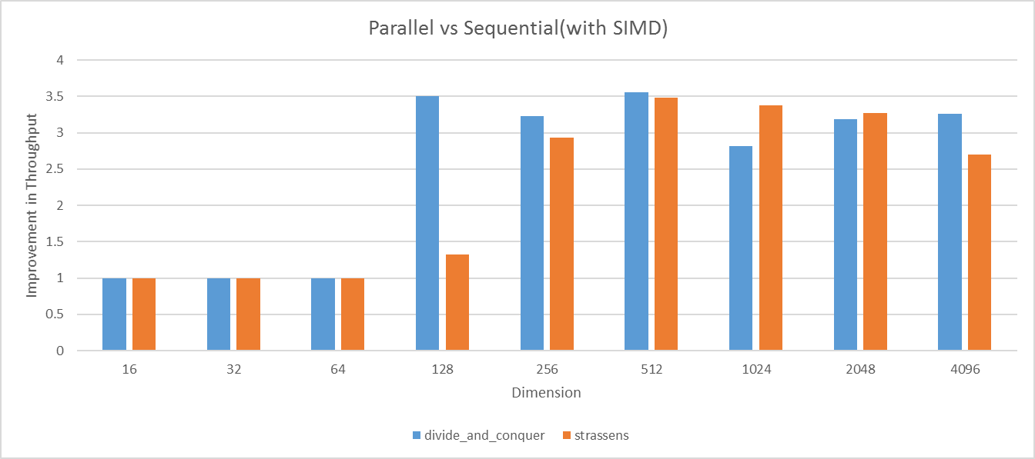
Results

Slide 9
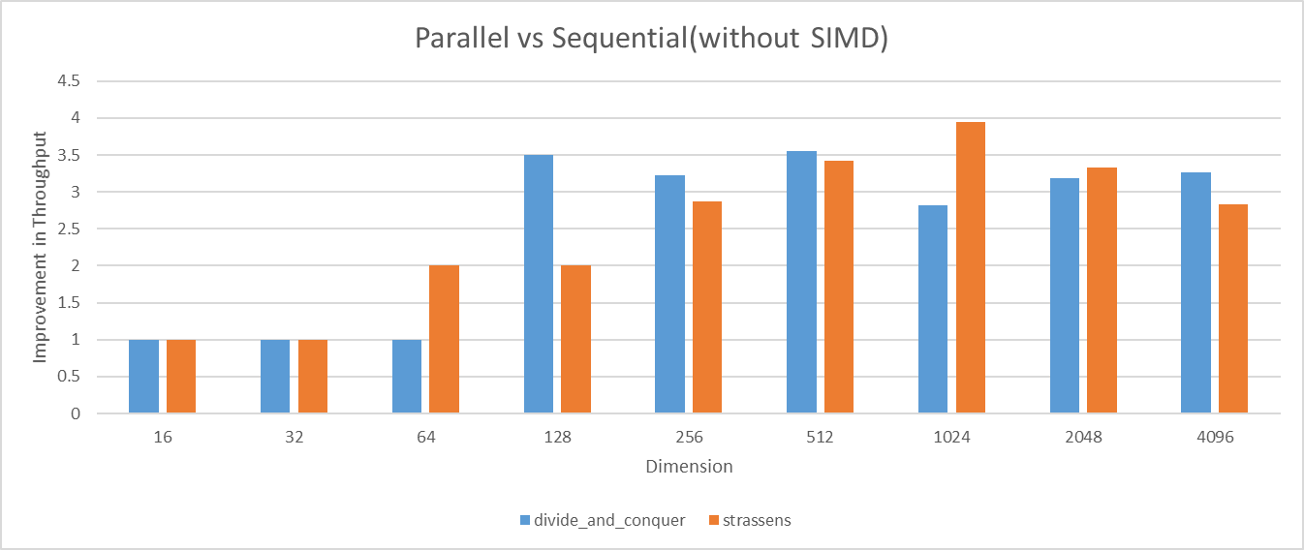
Results

Slide 10
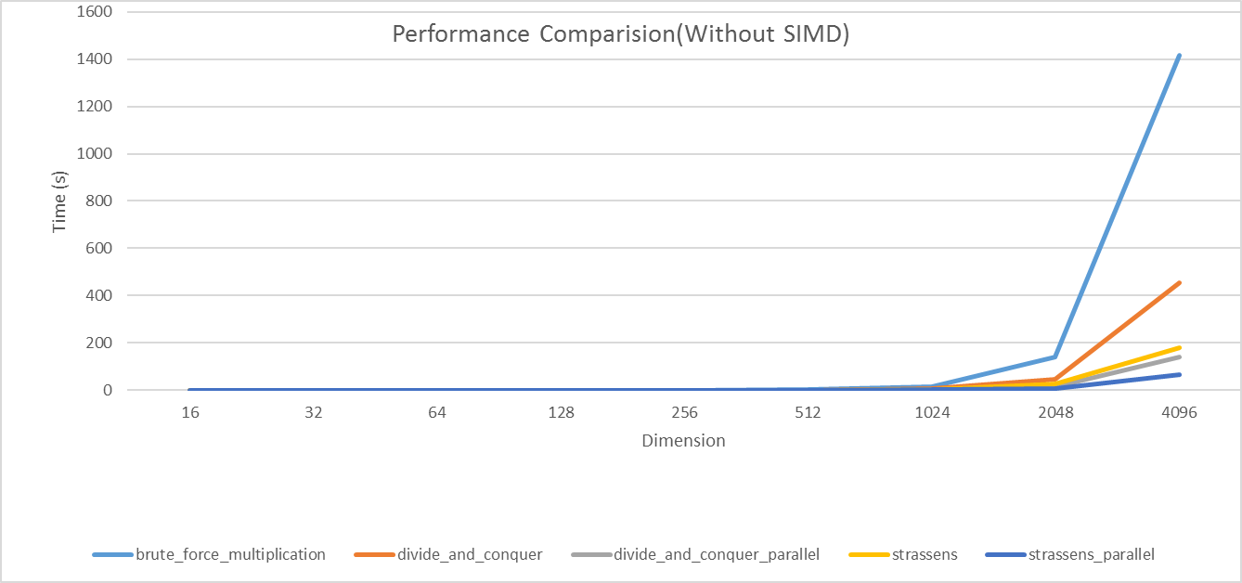
Results

Slide 11
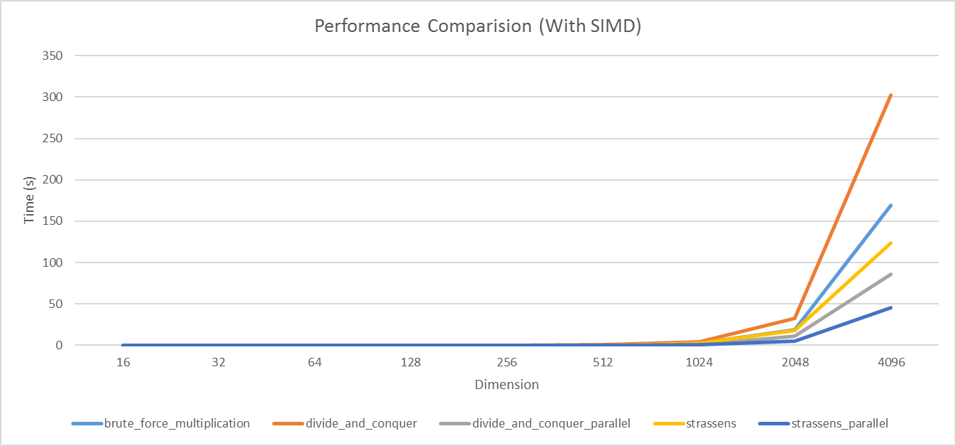
Results

Slide 12
Thank you

